Slide 1

Effects of Quantum Computing on Bitcoin
Or Sattath
Financial Cryptography and Data Security 2022

Slide 2
Implications for Bitcoin
Recall that a quantum attacker can break ECDSA.
Luckily, (modern) payments do not reveal the receiver’s public key; the public key is revealed only when a payment is made.

Slide 3
Unsafe Coins
A quantum adversary can steal any UTXO that is:
  Signed with ECDSA, and
  Whose public key is known
This includes:
  P2PK UTXOs
  P2PKH/Segwit UTXOs with a reused key
    Money transferred to an unsafe address
    Change address reusing the same public key
  P2PKH/Segwit UTXOs that were spent in a fork

Slide 4
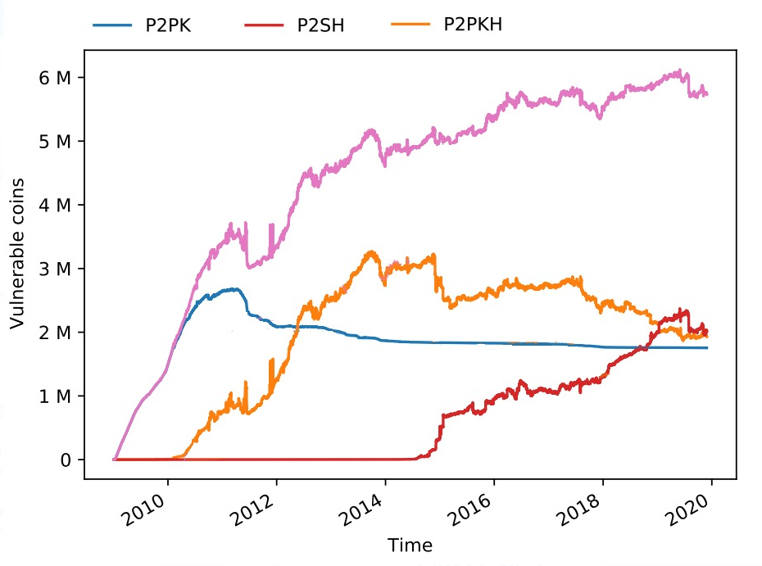
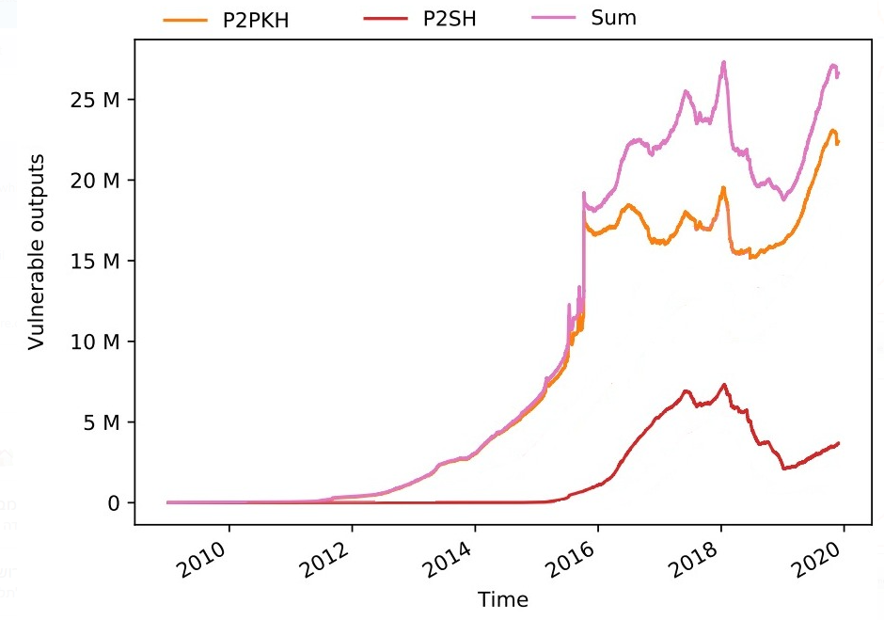
Unsafe Coins [IKK20]
At least 32% of all ₿ are unsafe (as of 2020, not counting P2PKH/Segwit spent on forks)
Graphs adapted from Ilie-Karantias-Knottenbelt 2020
Transition would take ~3 months. Entire UTXO count~70m
Notes:
Ilie-Karantias-Knottenbelt

Slide 5
Spending Safe Coins in the Post-Quantum Era
ECDSA P2PKH UTXOs are safe against quantum adversaries…
…as long as they are not spent!
Spending the UTXO requires posting the public key to the mempool
A quantum attacker could break it while it is in the mempool and post a competing UTXO!
Next: how can we avoid this hijacking attack?

Slide 6
Securely Migrating Funds to Post-Quantum signatures
Setting: we have a safe address, and ECDSA attacks have started.
How can we safely spend from these addresses, avoiding a hijacking attack?
Several proposed solutions:
  All based on a “commit-wait-reveal” approach (Guy Fawkes signatures)
  Require a soft fork

Slide 7
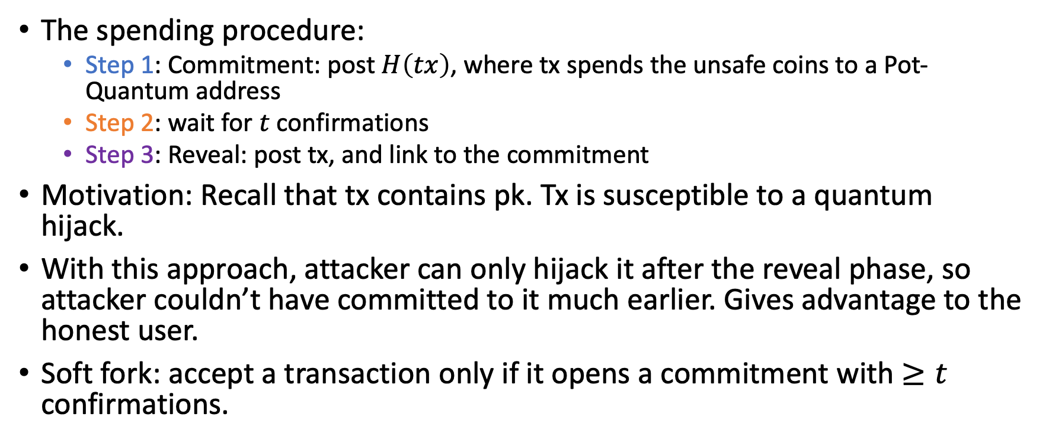
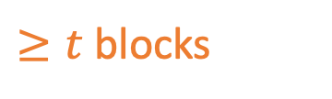
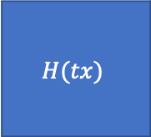
Securely Migrating Funds to Post-Quantum signatures
The spending procedure:
  Step 1: Commitment: post $H\left(tx\right)$, where tx spends the unsafe coins to a Pot-Quantum address
  Step 2: wait for $t$ confirmations
  Step 3: Reveal: post tx, and link to the commitment
Motivation: Recall that tx contains pk. Tx is susceptible to a quantum hijack.
With this approach, attacker can only hijack it after the reveal phase, so attacker couldn’t have committed to it much earlier. Gives advantage to the honest user.
Soft fork: accept a transaction only if it opens a commitment with $≥t$ confirmations.
…
$$H(tx)$$
$≥t$ blocks
tx

Slide 8
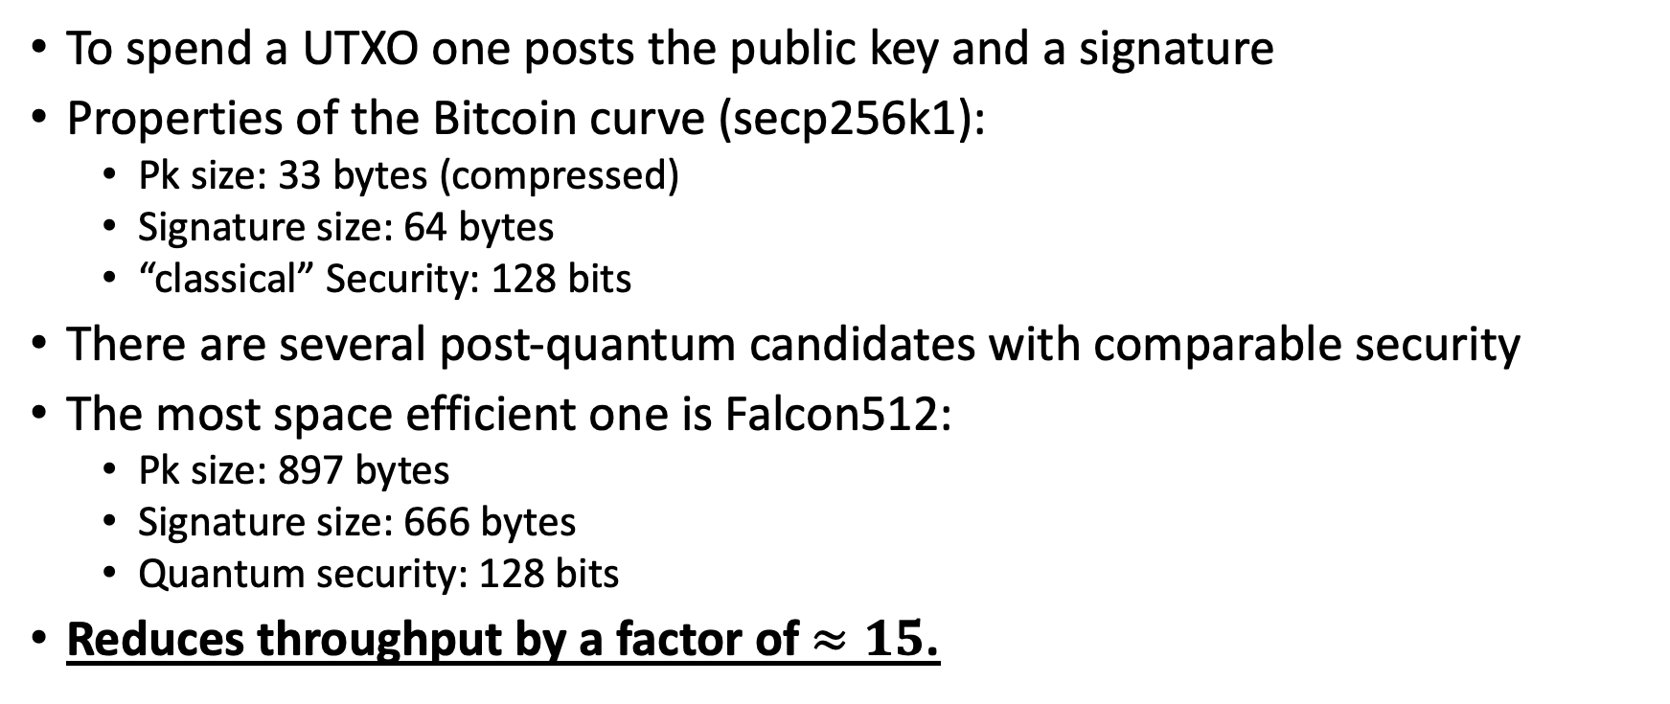
Post-Quantum Signatures and txn Throughput
To spend a UTXO one posts the public key and a signature
Properties of the Bitcoin curve (secp256k1):
  Pk size: 33 bytes (compressed)
  Signature size: 64 bytes
  “classical” Security: 128 bits
There are several post-quantum candidates with comparable security
The most space efficient one is Falcon512:
  Pk size: 897 bytes
  Signature size: 666 bytes
  Quantum security: 128 bits
Reduces throughput by a factor of $≈15$.

Slide 9
Quantum mining

Slide 10
Predictions for future
[Aggarwal et al.’17]
When quantum mining is expected to start?
  Educated estimates: After 2028, and before 2038.

Slide 11
Forks in Bitcoins
Occasionally, there may be a fork: two miners, who haven’t heard of each other’s block, find two blocks.
Longest chain rule: Honest users & miners follow the longest chain of blocks (hence, block-chain).
  For ties, mine on top of the tip which you have heard first. This is subjective: two honest miners may mine on top of two different longest tips.

Slide 12

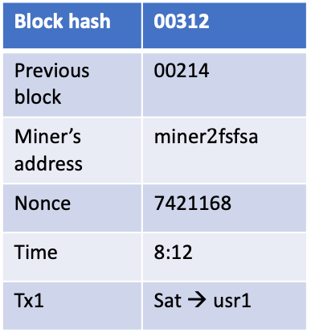
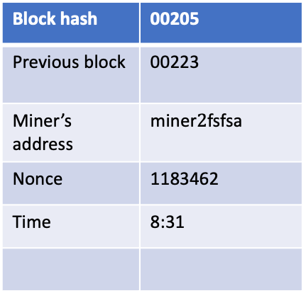
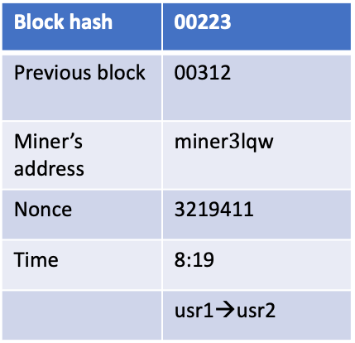
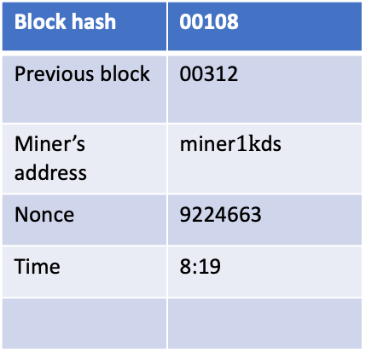
Block hash | 00108
Previous block | 00312
Miner’s address | miner$1k$ds
Nonce | 9224663
Time | 8:19
Block hash | 00214
Previous block | -
Miner’s address | Satoshi2ff
Nonce | 21231321
Time | 8:00
Block hash | 00312
Previous block | 00214
Miner’s address | miner$2$fsfsa
Nonce | 7421168
Time | 8:12
Tx1 | Sat → usr1
Block hash | 00223
Previous block | 00312
Miner’s address | miner$3$lqw
Nonce | 3219411
Time | 8:19
 | usr1→usr2
Block hash | 00205
Previous block | 00223
Miner’s address | miner$2\text{fsfs}$a
Nonce | 1183462
Time | 8:31
Miner 1
Miner 2
Miner 3
00108
00223

Slide 13
Implications of quantum mining
Grover’s algorithm can be applied to find solutions for Proof of work puzzles
Suppose we have quantum miners, that use Grover’s algorithm.
Immediate consequence: the difficulty of mining will increase.
  Not really a problem.
  This was well known.

Slide 14
Implications of quantum mining [S’20]
Suppose your fellow miner found a block. What do you do?
  Strategy 1: Stop everything and start to mine on top of the new block.
  Strategy 2: Measure the quantum state immediately, hoping to find a block, and to propagate it faster than your fellow miner. If the block becomes part of the longest chain, you win!
Rational miners will use strategy 2, as it is strictly better.
Strategy 1 wastes all the work you’ve done in the past few minutes!
Once one miner finds a block, all others will measure their state → Strong correlation between the time different miners measure their state.
May lead to more forks in the blockchain.
  Recall: The stale rate (#blocks outside longest chain / total #blocks)
  Classically, forks happen due to propagation time / network effects. Stale rate → 0 as propagation time decreases.
  In the quantum setting, forks happen due to above mentioned reason. Stale rate does not go to zero as propagation time is decreased.

Slide 15
Suppose all miners are symmetric, and they choose the same number of Grover iterations to apply, which takes t minutes. What would be the stale rate (in difficulty adjustment equilibrium)?

Slide 16
Proposed countermeasure (Intuition)
Solution should prohibit the adaptive strategy.
Force miners to choose how many Grover iterations they will apply, in advance.

Slide 17
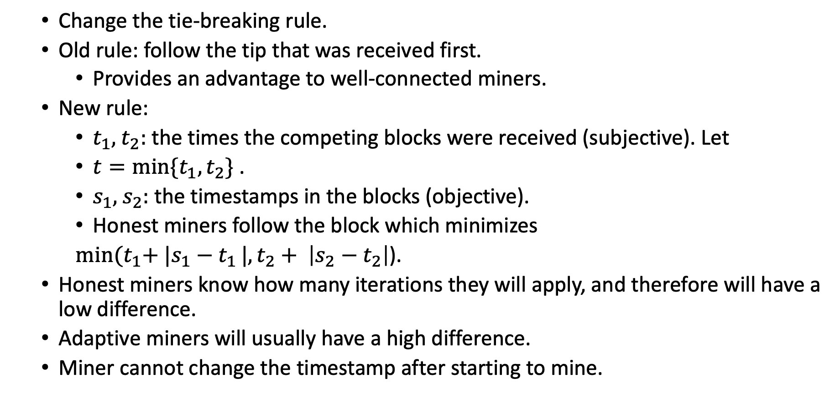
Proposed countermeasure
  Change the tie-breaking rule.
  Old rule: follow the tip that was received first.
    Provides an advantage to well-connected miners.
  New rule:
    $t_{1},$ $t_{2}:$ the times the competing blocks were received (subjective). Let
    $t=\min{{\{t}_{1},t_{2}\} }$.
    $s_{1},$ $s_{2}:$ the timestamps in the blocks (objective).
    Honest miners follow the block which minimizes
    $\min{{(t}_{1}+ |s_{1}−t_{1}}|,t_{2}+ \left|s_{2}−t_{2}\right|$).
  Honest miners know how many iterations they will apply, and therefore will have a low difference.
  Adaptive miners will usually have a high difference.
  Miner cannot change the timestamp after starting to mine.

Slide 18
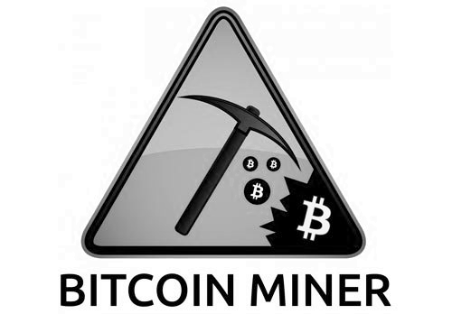
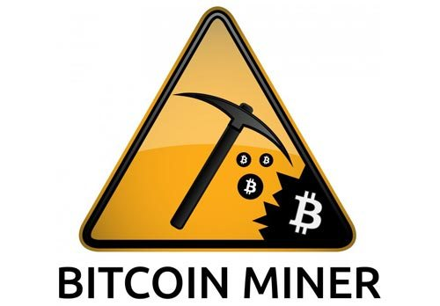
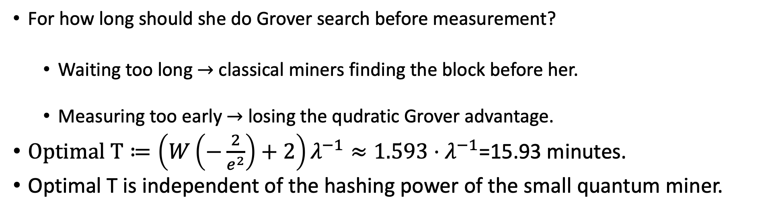
How do we know Quantum Mining has started?
Nerem-Gaur’21
All miners are classical
A single quantum miner
Quantum Miner
Classical Miner
Classical Miner
Classical Miner
Classical Miner
Classical Miner
Dilemma for the quantum miner
For how long should she do Grover search before measurement?
  Waiting too long $→$ classical miners finding the block before her.
  Measuring too early $→$ losing the qudratic Grover advantage.
$Optimal T≔\left(W\left(−\frac{2}{e^{2}}\right)+2\right)λ^{−1}≈1.593⋅λ^{−1}$=15.93 minutes.
Optimal T is independent of the hashing power of the small quantum miner.
Lambert W function

Slide 19
Quantum fingerpring of quantum mining
Nerem-Gaur’21
Quantum Miner
Classical Miner
Classical Miner
Classical Miner
Classical Miner
Classical Miner
Quantum miner will roughly measure after 15.93 minutes.
Quantum fingerprint: Unusual spike in the probability of finding a block by the network at 15.93 minutes.
If you see a spike Quantum Mining has begun!
  I checked and didn’t notice such spike :-(

Slide 20
Nash-Equilibrium strategy for Quantum miners?
Lee-Ray-Santha’19
Classical miners doing brute force, at any instant know if they have won.
Quantum miners doing Grover’s search, need to measure the state to know if they have won.
Quantum strategy: Deciding how many Grover iterations to apply.

Slide 21
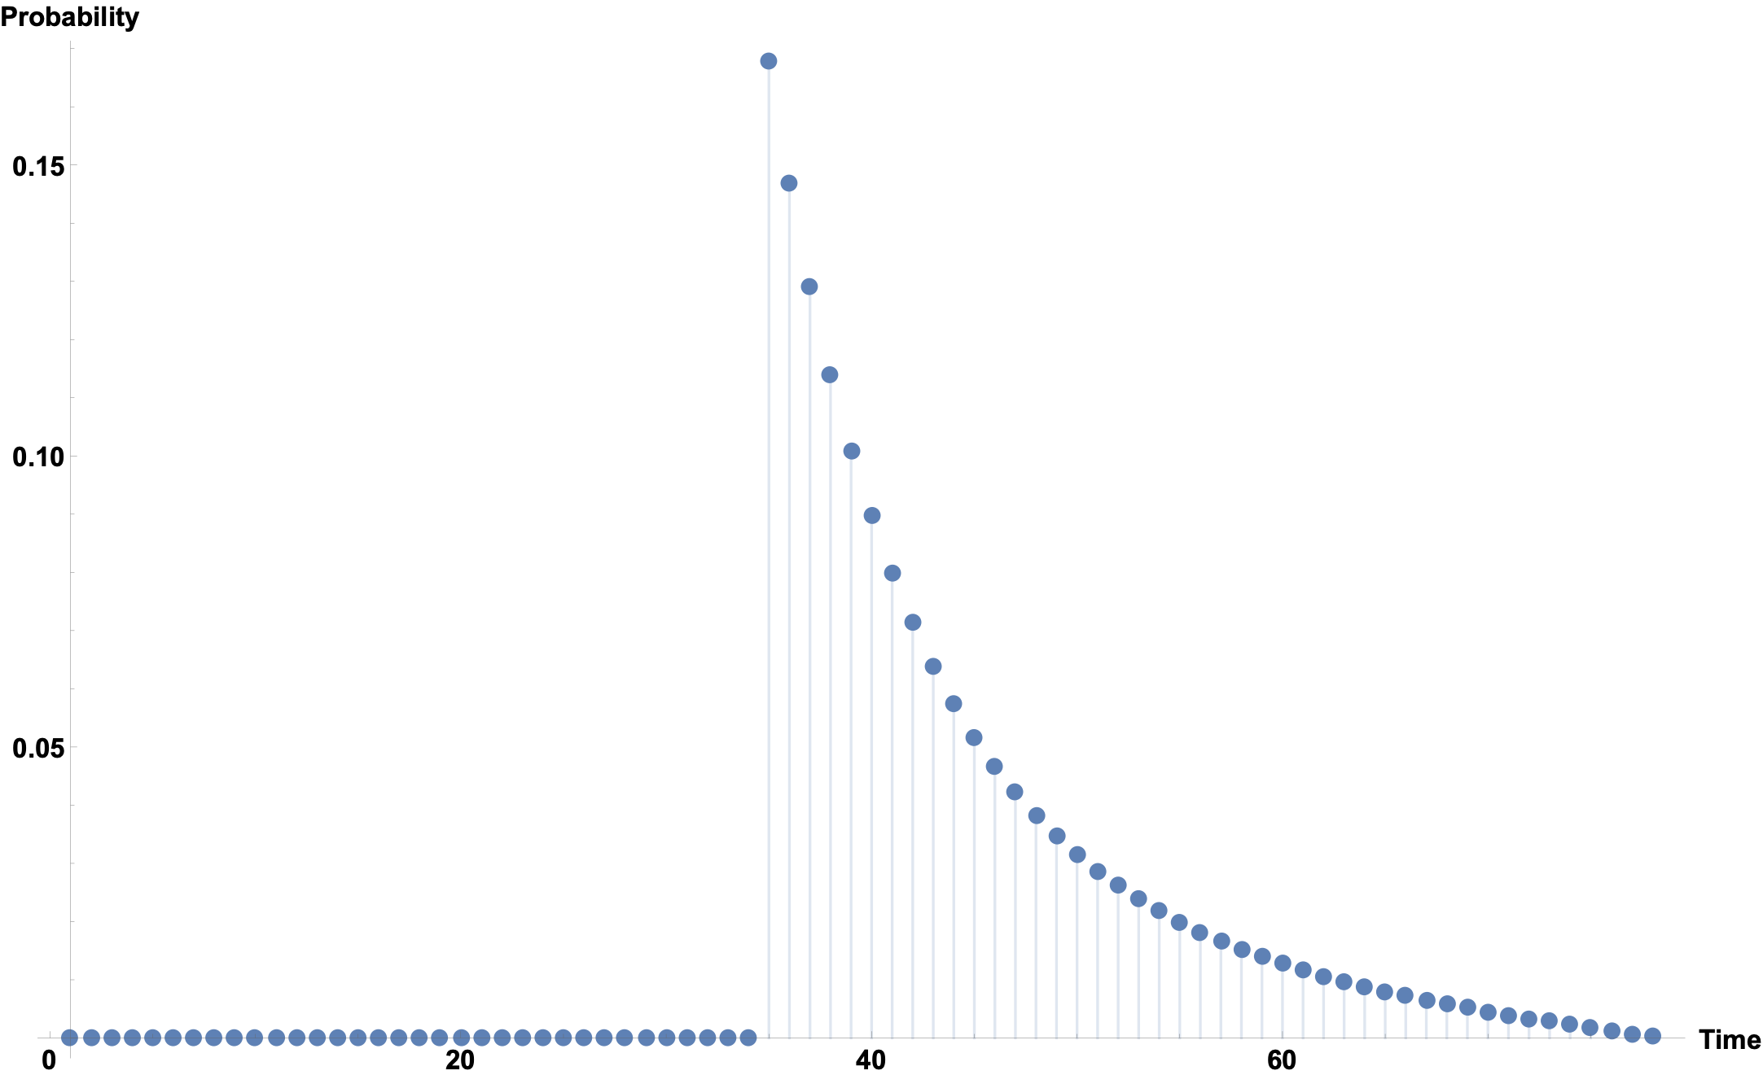
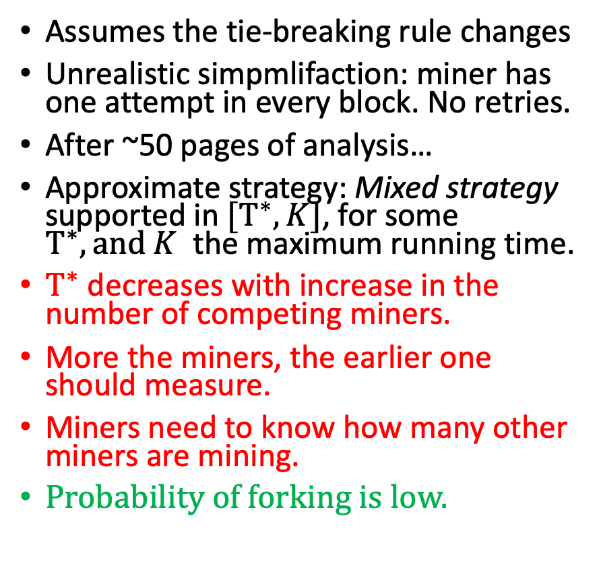
Nash-Equilibrium strategy for Quantum miners
Lee-Ray-Santha’19
Assumes the tie-breaking rule changes
Unrealistic simpmlifaction: miner has one attempt in every block. No retries.
After ~50 pages of analysis…
Approximate strategy: Mixed strategy supported in $[T^{∗},K]$, for some $T^{∗}, and K$ the maximum running time.
$T^{∗}$ decreases with increase in the number of competing miners.
More the miners, the earlier one should measure.
Miners need to know how many other miners are mining.
Probability of forking is low.
Grover iterations

Slide 22
Discussion & Open questions
Is the proposed solution regarding tie-breaking rule secure?
  Does it introduce other risks, related to timing attacks?
  Selfish mining, Infiltration attacks and Pool hopping have to be addressed.
What’s the quantum mining equilibrium, if retries are considered?
How can a quantum miner learn the parameters needed in order to figure out the optimal strategy?
Quantum mining is not progress-free. What are the other implications?
  Obvious ones: Classically, twice-as-fast miner is worth twice. For a quantum miner, twice-as-fast is worth quadruple.
Is the high-stale rate really a problem in the quantum setting?
  Classically, a high-stale rate causes problems. I can’t see any effect on security or efficiency in the quantum setting. Essentially, a quantum attacker will also have a high stale-rate, whereas a classical miner can decrease its own stale-rate to essentially 0, and get an unfair advantage.
Any motivation to whether quantum mining has started?

